Slide 1
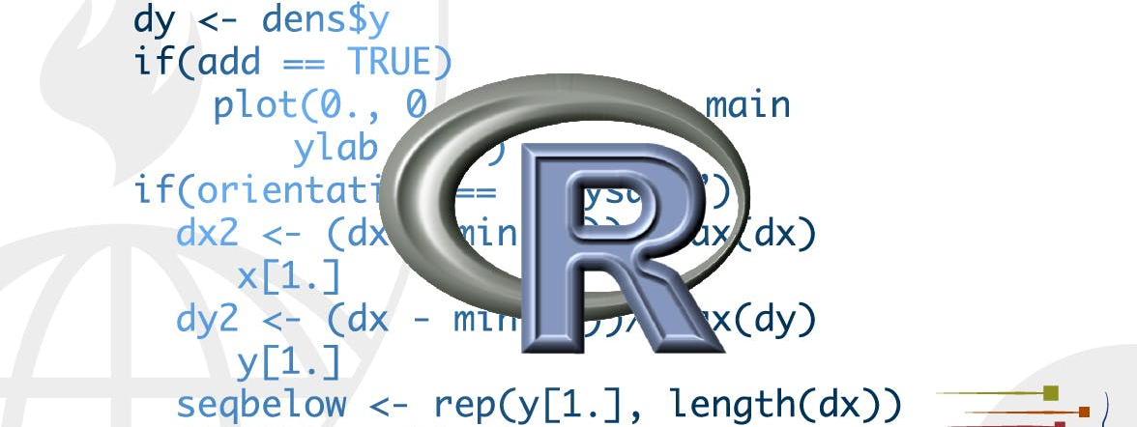
Programming in r
STA 4233 Introduction to Programming and Data Management in R
Notes:
In this part of the course, you’ll improve your programming skills. Programming is a cross-cutting skill needed for all data science work: you must use a computer to do data science; you cannot do it in your head, or with pencil and paper.

Slide 2
introduction
Visualize
Import
Tidy
Transform
Communicate
Model
Understand
Program
Notes:
Programming produces code, and code is a tool of communication. Obviously code tells the computer what you want it to do. But it also communicates meaning to other humans. Thinking about code as a vehicle for communication is important because every project you do is fundamentally collaborative. Even if you’re not working with other people, you’ll definitely be working with future-you! Writing clear code is important so that others (like future-you) can understand why you tackled an analysis in the way you did. That means getting better at programming also involves getting better at communicating. Over time, you want your code to become not just easier to write, but easier for others to read.
Writing code is similar in many ways to writing prose. One parallel which I find particularly useful is that in both cases rewriting is the key to clarity. The first expression of your ideas is unlikely to be particularly clear, and you may need to rewrite multiple times. After solving a data analysis challenge, it’s often worth looking at your code and thinking about whether or not it’s obvious what you’ve done. If you spend a little time rewriting your code while the ideas are fresh, you can save a lot of time later trying to recreate what your code did. But this doesn’t mean you should rewrite every function: you need to balance what you need to achieve now with saving time in the long run. (But the more you rewrite your functions the more likely your first attempt will be clear.)

Slide 3
What you’ll learn
dive deep into the pipe, %>%
write functions which let you extract out repeated code so that it can be easily reused.
R’s data structures
iteration that let you do similar things again and again
Notes:
In the following four chapters, you’ll learn skills that will allow you to both tackle new programs and to solve existing problems with greater clarity and ease:
In pipes, you will dive deep into the pipe, %>%, and learn more about how it works, what the alternatives are, and when not to use it.
Copy-and-paste is a powerful tool, but you should avoid doing it more than twice. Repeating yourself in code is dangerous because it can easily lead to errors and inconsistencies. Instead, in functions, you’ll learn how to write functions which let you extract out repeated code so that it can be easily reused.
As you start to write more powerful functions, you’ll need a solid grounding in R’s data structures, provided by vectors. You must master the four common atomic vectors, the three important S3 classes built on top of them, and understand the mysteries of the list and data frame.
Functions extract out repeated code, but you often need to repeat the same actions on different inputs. You need tools for iteration that let you do similar things again and again. These tools include for loops and functional programming, which you’ll learn about in iteration.

Slide 4
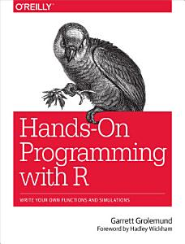
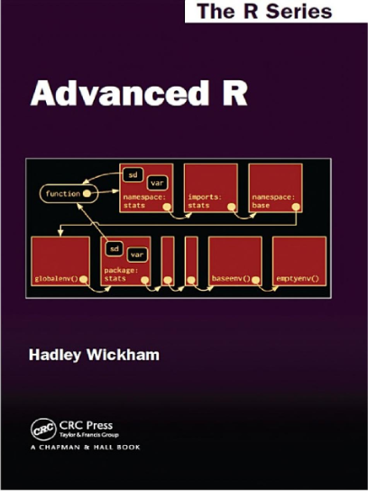
Learning more
Hands on Programming with R, by Garrett Grolemund
Advanced R by Hadley Wickham
Notes:
The goal of these chapters is to teach you the minimum about programming that you need to practice data science, which turns out to be a reasonable amount. Once you have mastered the material in this book, I strongly believe you should invest further in your programming skills. Learning more about programming is a long-term investment: it won’t pay off immediately, but in the long term it will allow you to solve new problems more quickly, and let you reuse your insights from previous problems in new scenarios.
Hands on Programming with R, by Garrett Grolemund. This is an introduction to R as a programming language and is a great place to start if R is your first programming language. It covers similar material to these chapters, but with a different style and different motivation examples (based in the casino). It’s a useful complement if you find that these four chapters go by too quickly.
Advanced R by Hadley Wickham. This dives into the details of R the programming language. This is a great place to start if you have existing programming experience. It’s also a great next step once you’ve internalised the ideas in these chapters. You can read it online at http://adv-r.had.co.nz.

Slide 5
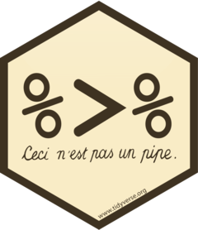
Pipes
library(magrittr)
Notes:
Pipes are a powerful tool for clearly expressing a sequence of multiple operations. So far, you’ve been using them without knowing how they work, or what the alternatives are. Now, in this chapter, it’s time to explore the pipe in more detail. You’ll learn the alternatives to the pipe, when you shouldn’t use the pipe, and some useful related tools.
The pipe, %>%, comes from the magrittr package by Stefan Milton Bache. Packages in the tidyverse load %>% for you automatically, so you don’t usually load magrittr explicitly. Here, however, we’re focussing on piping, and we aren’t loading any other packages, so we will load it explicitly.

Slide 6
Piping alternatives
hop()
Little bunny Foo Foo Went hopping through the forest Scooping up the field mice And bopping them on the head
scoop()
bop()
foo_foo <- little_bunny()
Save each intermediate step as a new object.
Overwrite the original object many times.
Compose functions.
Use the pipe.
Notes:
he point of the pipe is to help you write code in a way that is easier to read and understand. To see why the pipe is so useful, we’re going to explore a number of ways of writing the same code. Let’s use code to tell a story about a little bunny named Foo Foo:
This is a popular Children’s poem that is accompanied by hand actions.
And we’ll use a function for each key verb: hop(), scoop(), and bop(). Using this object and these verbs, there are (at least) four ways we could retell the story in code:
And we’ll use a function for each key verb: hop(), scoop(), and bop(). Using this object and these verbs, there are (at least) four ways we could retell the story in code:
Save each intermediate step as a new object.
Overwrite the original object many times.
Compose functions.
Use the pipe.
We’ll work through each approach, showing you the code and talking about the advantages and disadvantages.

Slide 7
1. intermediate steps
foo_foo_1 <- hop(foo_foo, through = forest)
foo_foo_2 <- scoop(foo_foo_1, up = field_mice)
foo_foo_3 <- bop(foo_foo_2, on = head)
Notes:
The simplest approach is to save each step as a new object:
The main downside of this form is that it forces you to name each intermediate element. If there are natural names, this is a good idea, and you should do it. But many times, like this in this example, there aren’t natural names, and you add numeric suffixes to make the names unique. That leads to two problems:
The code is cluttered with unimportant names
You have to carefully increment the suffix on each line.
Whenever I write code like this, I invariably use the wrong number on one line and then spend 10 minutes scratching my head and trying to figure out what went wrong with my code.

Slide 8
So many copies of data
diamonds <- ggplot2::diamonds
diamonds2 <- diamonds %>%
dplyr::mutate(price_per_carat = price / carat)
pryr::object_size(diamonds)
#> Registered S3 method overwritten by 'pryr’:
#> method from
#> print.bytes Rcpp
#> 3.46 MB
pryr::object_size(diamonds2)
#> 3.89 MB
pryr::object_size(diamonds, diamonds2)
#> 3.89 MB
Notes:
You may also worry that this form creates many copies of your data and takes up a lot of memory. Surprisingly, that’s not the case. First, note that proactively worrying about memory is not a useful way to spend your time: worry about it when it becomes a problem (i.e. you run out of memory), not before. Second, R isn’t stupid, and it will share columns across data frames, where possible. Let’s take a look at an actual data manipulation pipeline where we add a new column to ggplot2::diamonds:
pryr::object_size() gives the memory occupied by all of its arguments. The results seem counterintuitive at first:
diamonds takes up 3.46 MB,
diamonds2 takes up 3.89 MB,
diamonds and diamonds2 together take up 3.89 MB!
How can that work? Well, diamonds2 has 10 columns in common with diamonds: there’s no need to duplicate all that data, so the two data frames have variables in common. These variables will only get copied if you modify one of them.

Slide 9
collective size increases
diamonds$carat[1] <- NA
pryr::object_size(diamonds)
#> 3.46 MB
pryr::object_size(diamonds2)
#> 3.89 MB
pryr::object_size(diamonds, diamonds2)
#> 4.32 MB
Notes:
. In the following example, we modify a single value in diamonds$carat. That means the carat variable can no longer be shared between the two data frames, and a copy must be made. The size of each data frame is unchanged, but the collective size increases:
(Note that we use pryr::object_size() here, not the built-in object.size(). object.size() only takes a single object so it can’t compute how data is shared across multiple objects.)

Slide 10

2. Overwrite the original
foo_foo <- hop(foo_foo, through = forest)
foo_foo <- scoop(foo_foo, up = field_mice)
foo_foo <- bop(foo_foo, on = head)
Notes:
Instead of creating intermediate objects at each step, we could overwrite the original object:
This is less typing (and less thinking), so you’re less likely to make mistakes. However, there are two problems:
Debugging is painful: if you make a mistake you’ll need to re-run the complete pipeline from the beginning.
The repetition of the object being transformed (we’ve written foo_foo six times!) obscures what’s changing on each line.

Slide 11

3. Function composition
bop(
scoop(
hop(foo_foo, through = forest),
up = field_mice
),
on = head
)
Notes:
Another approach is to abandon assignment and just string the function calls together:
Here the disadvantage is that you have to read from inside-out, from right-to-left, and that the arguments end up spread far apart (evocatively called the dagwood sandwhich problem). In short, this code is hard for a human to consume.

Slide 12
4. Use the pipe
foo_foo %>%
hop(through = forest) %>%
scoop(up = field_mice) %>%
bop(on = head)
Notes:
Finally, we can use the pipe:
This is my favourite form, because it focusses on verbs, not nouns. You can read this series of function compositions like it’s a set of imperative actions. Foo Foo hops, then scoops, then bops. The downside, of course, is that you need to be familiar with the pipe. If you’ve never seen %>% before, you’ll have no idea what this code does. Fortunately, most people pick up the idea very quickly, so when you share your code with others who aren’t familiar with the pipe, you can easily teach them.

Slide 13
Lexical transformation
my_pipe <- function(.) {
. <- hop(., through = forest)
. <- scoop(., up = field_mice)
bop(., on = head)
}
my_pipe(foo_foo)
Notes:
The pipe works by performing a “lexical transformation”: behind the scenes, magrittr reassembles the code in the pipe to a form that works by overwriting an intermediate object. When you run a pipe like the one above, magrittr does something like this:

Slide 14
Pipe doesn’t work
Functions that use the current environment.
env <- environment()
"x" %>% assign(100, envir = env)
x
#> [1] 100
assign("x", 10)
x
#> [1] 10
"x" %>% assign(100)
x
#> [1] 10
get()
load()
Notes:
This means that the pipe won’t work for two classes of functions:
Functions that use the current environment. For example, assign() will create a new variable with the given name in the current environment:
The use of assign with the pipe does not work because it assigns it to a temporary environment used by %>%. If you do want to use assign with the pipe, you must be explicit about the environment:
Other functions with this problem include get() and load().

Slide 15
Functions that use lazy evaluation
tryCatch(stop("!"), error = function(e) "An error")
#> [1] "An error"
stop("!") %>%
tryCatch(error = function(e) "An error")
#> Error in eval(lhs, parent, parent): !
try()
suppressMessages()
suppressWarnings()
Notes:
Functions that use lazy evaluation. In R, function arguments are only computed when the function uses them, not prior to calling the function. The pipe computes each element in turn, so you can’t rely on this behaviour.
One place that this is a problem is tryCatch(), which lets you capture and handle errors:
There are a relatively wide class of functions with this behaviour, including try(), suppressMessages(), and suppressWarnings() in base R.

Slide 16
When not to use the pipe
Your pipes are longer than (say) ten steps
You have multiple inputs or outputs
You are starting to think about a directed graph with a complex dependency structure
Notes:
The pipe is a powerful tool, but it’s not the only tool at your disposal, and it doesn’t solve every problem! Pipes are most useful for rewriting a fairly short linear sequence of operations. I think you should reach for another tool when:
Your pipes are longer than (say) ten steps. In that case, create intermediate objects with meaningful names. That will make debugging easier, because you can more easily check the intermediate results, and it makes it easier to understand your code, because the variable names can help communicate intent.
You have multiple inputs or outputs. If there isn’t one primary object being transformed, but two or more objects being combined together, don’t use the pipe.
You are starting to think about a directed graph with a complex dependency structure. Pipes are fundamentally linear and expressing complex relationships with them will typically yield confusing code.

Slide 17
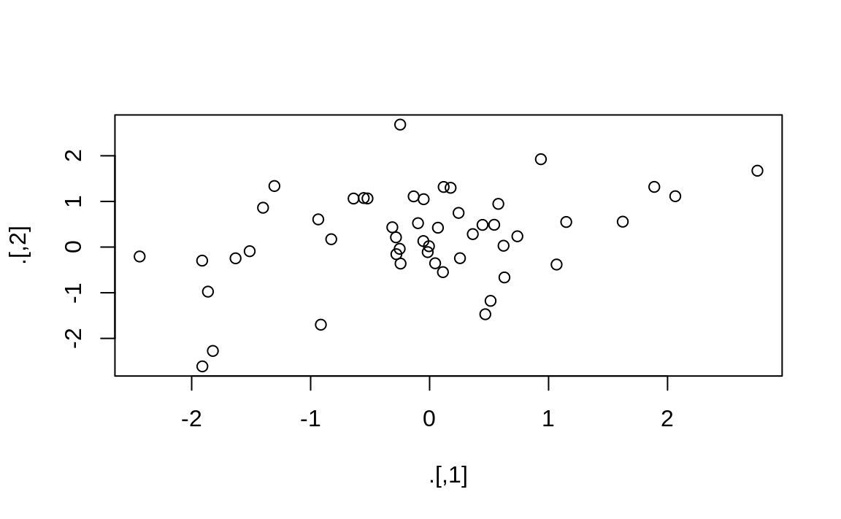
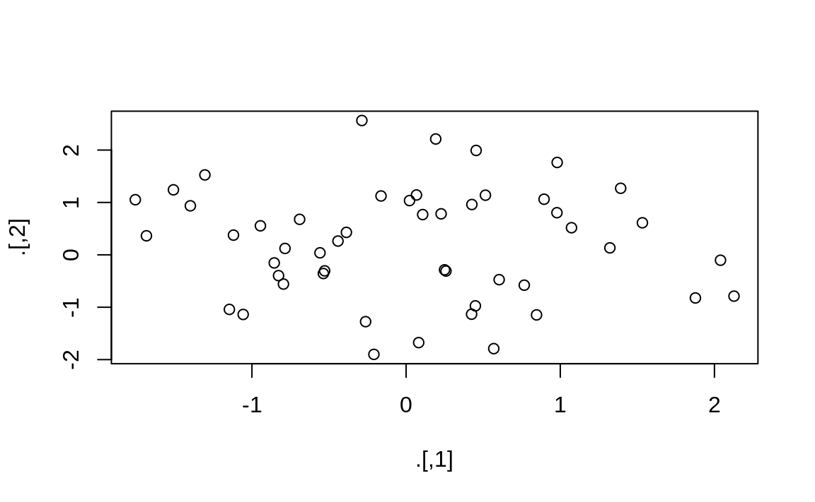
Other tools from magrittr %T>%
rnorm(100) %>%
matrix(ncol = 2) %>%
plot() %>%
str()
#> NULL
rnorm(100) %>%
matrix(ncol = 2) %T>%
plot() %>%
str()
#> num [1:50, 1:2] -0.387 -0.785 -1.057 -0.796 -1.756 ...
Notes:
All packages in the tidyverse automatically make %>% available for you, so you don’t normally load magrittr explicitly. However, there are some other useful tools inside magrittr that you might want to try out:
When working with more complex pipes, it’s sometimes useful to call a function for its side-effects. Maybe you want to print out the current object, or plot it, or save it to disk. Many times, such functions don’t return anything, effectively terminating the pipe.
To work around this problem, you can use the “tee” pipe. %T>% works like %>% except that it returns the left-hand side instead of the right-hand side. It’s called “tee” because it’s like a literal T-shaped pipe.

Slide 18
Other tools from magrittr %$%
mtcars %$%
cor(disp, mpg)
#> [1] -0.848
Notes:
If you’re working with functions that don’t have a data frame based API (i.e. you pass them individual vectors, not a data frame and expressions to be evaluated in the context of that data frame), you might find %$% useful. It “explodes” out the variables in a data frame so that you can refer to them explicitly. This is useful when working with many functions in base R:

Slide 19
Other tools from magrittr %<>%
mtcars <- mtcars %>%
transform(cyl = cyl * 2)
with
mtcars %<>%
transform(cyl = cyl * 2)
Notes:
For assignment magrittr provides the %<>% operator which allows you to replace code like:
I’m not a fan of this operator because I think assignment is such a special operation that it should always be clear when it’s occurring. In my opinion, a little bit of duplication (i.e. repeating the name of the object twice) is fine in return for making assignment more explicit.

